Slide 1
Cloud-Based Integration Solutions
SE495: Software and Systems Integration

Slide 2
Outline
Introduction to cloud-based integration
Integration platform as a service (iPaaS)
Microservices and containerization
Serverless computing and functions as a service (FaaS)
Security, compliance, and monitoring considerations

Slide 3
Introduction to cloud-based integration

Slide 4
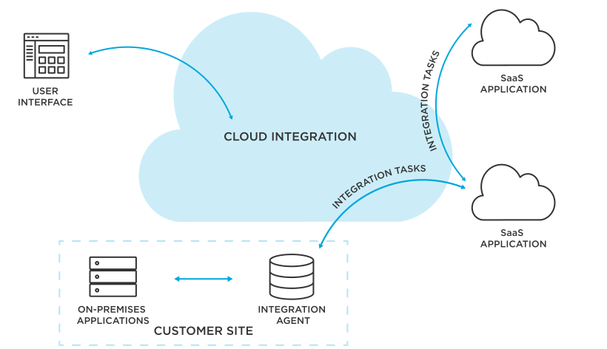
What is cloud-based integration?
Cloud-based integration is the process of connecting and exchanging data between applications and systems that are hosted in the cloud.
Cloud-based integration solutions offer a number of advantages over traditional integration methods, including:
Reduced costs
Increased agility
Improved scalability
Enhanced security

Slide 5
Cloud-based integration Challenges
Complexity
(compatibility issues, data inconsistencies, and other technical challenges)
Security
(hacking, data breaches, and unauthorized access)
Performance
(slow response times, poor user experience, and reduced productivity)
Governance and compliance
(data privacy, regulatory compliance, and data ownership)
Vendor lock-in

Slide 6
Cloud-based integration Architecture
There are several key components that make up a typical cloud-based integration architecture:
Cloud-based applications and services
Software-as-a-Service (SaaS) applications, Platform-as-a-Service (PaaS) platforms, or Infrastructure-as-a-Service (IaaS) services.
Integration platform
cloud-based or on-premises.
Connectors and adapters
Connectors and adapters may be pre-built or custom-built.
Data transformation and mapping
Data transformation and mapping may be done using a visual mapping tool or a programming language.

Slide 7
Cloud-based integration Architecture
There are several key components that make up a typical cloud-based integration architecture:
API management
API management involves monitoring API usage, enforcing security policies, and managing API versions.
Security
Robust security measures in place to protect data and systems from unauthorizedaccess, data breaches, and other security threats.
Governance and compliance
This may include data privacy, regulatory compliance, and data ownership.

Slide 8
Cloud-based integration Architecture
There are several key components that make up a typical cloud-based integration architecture:
Scalability and performance
load balancing, caching, and other performance optimization techniques.
Monitoring and management
monitoring performance, troubleshooting issues, and applying updates and patches.

Slide 9
Common integration scenarios
Application integration
(such as CRM, ERP, HR, and supply chain management systems)
Data integration
(such as enterprise databases, data warehouses, and cloud-based storage services)
Business-to-Business (B2B) integration
(such as suppliers, partners, and customers)
Mobile integration
(Integrating mobile devices and applications with backend systems)

Slide 10
Common integration scenarios
Internet of Things (IoT) integration
(Integrating IoT devices and sensors with backend systems)
Social media integration
(Integrating social media data with backend systems)
Cloud-to-cloud integration
(Integrating data and processes between different cloud-based services)
Legacy system integration
(Integrating legacy systems with modern cloud-based applications and services)

Slide 11
Cloud-based integration platforms
Integration Platform-as-a-Service (iPaaS)
Enterprise Service Bus-as-a-Service (ESBaaS)
API Management Platforms
Data Integration Platforms
Messaging Platforms
Event-Driven Architecture (EDA) Platforms

Slide 12
Integration platform as a service (iPaaS)

Slide 13
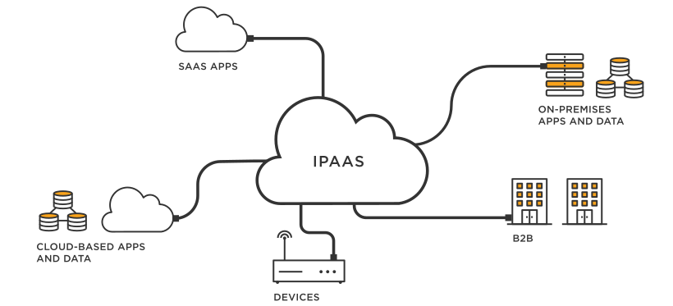
What is iPaaS?
Integration Platform as a Service (iPaaS) is a cloud-based platform that provides the tools and services needed to integrate applications and data.
iPaaS solutions offer a number of advantages over traditional integration methods, including:
Reduced costs
Increased agility
Improved scalability
Enhanced security

Slide 14
Components of iPaaS
iPaaS solutions typically include the following components:
A data integration engine
A message broker
A workflow engine
A user interface

Slide 15
Key features of iPaaS
Connectivity
Pre-built connectors
Data mapping tools
Workflow automation
API management
Ease of use

Slide 16
Popular iPaaS solutions
MuleSoft Anypoint Platform
IBM Cloud Integration Platform
Oracle Integration Cloud Service
SAP Cloud Platform Integration
Microsoft Azure Integration Services

Slide 17
Microservices and containerization

Slide 18
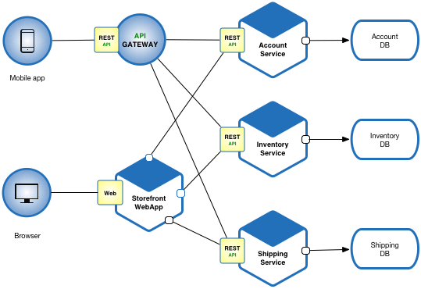
Microservices
Microservices is a software development architecture that involves breaking down a large application into smaller, independent components or services.
Each service is responsible for a specific function or feature of the application and communicates with other services through well-defined APIs.

Slide 19
What is Microservices?
“Microservices are a thing these days.”
Phil Calçado, former Director of Engineering, SoundCloud
“Microservices are small, autonomous services that work together.”
Sam Newman, Thoughtworks
“Loosely coupled service-oriented architecture with bounded contexts.”
Adrian Cockcroft, Battery Ventures
“A microservice is an independently deployable component of bounded scope that supports interoperability through message-based communication.”
“Microservice Architecture-Aligning Principles, Practices, and Culture”

Slide 20
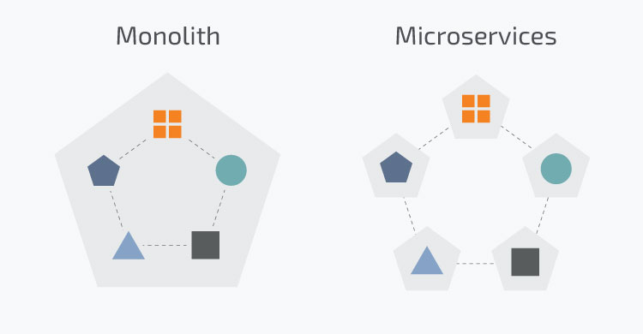
Microservices
Traditionally applications were built in a monolithic architecture style
Single unit with client-side apps, server-side apps and a database managed and served in one place
However, modern applications are built in a microservices architecture
Smaller, independent units that carry out every application process as a separate service

Slide 21
Why use Microservices?
Independent components that can be updated and deployed separately
A bug in one microservice does not impact any other microservice
Easier to understand and manage small units of code
Better scalability as each unit can scale independently
More freedom in tech selection as each microservice can use a different language and framework
But increase in complexity as each microservice needs to be able to talk to each other

Slide 22
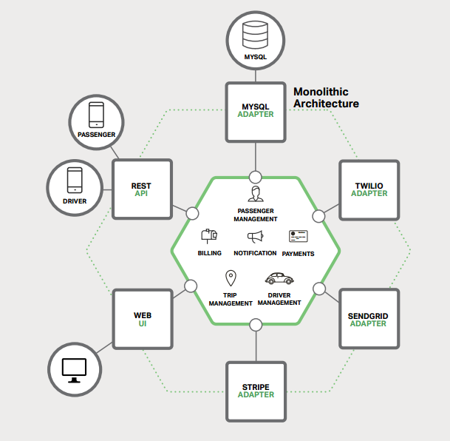
Building Monolithic Applications
These applications are simple to test and debug.
These applications are also simple to deploy.
These applications are scalable.

Slide 23
Issues with Monolithic Applications
In time the application become too complex.
Being too large is very difficult for any developer to fully understand.
A large application is an obstacle to continuous deployment.
Another problem with monolithic applications is reliability.

Slide 24
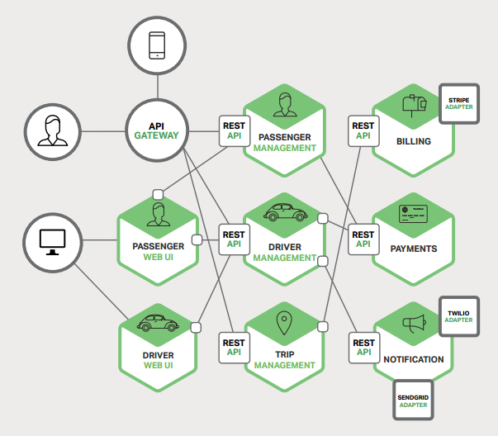
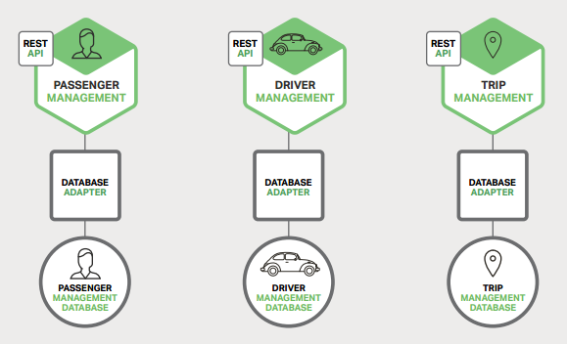
Microservices – Tackling Complexity

Slide 25
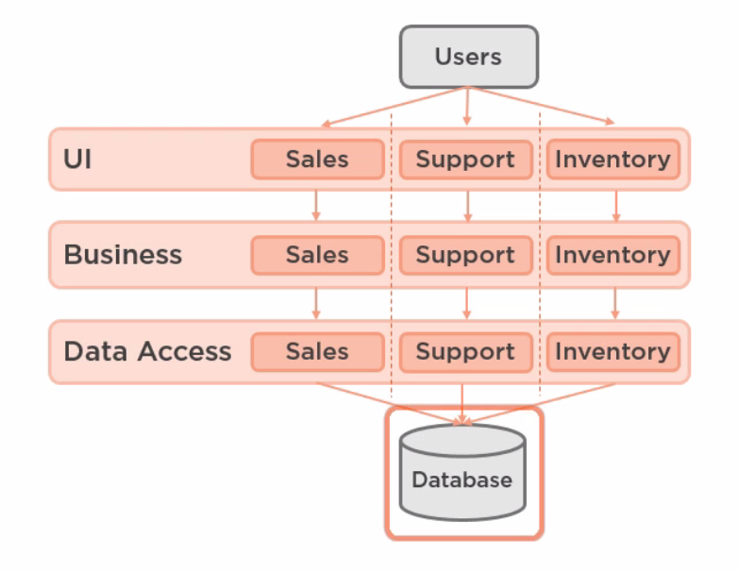
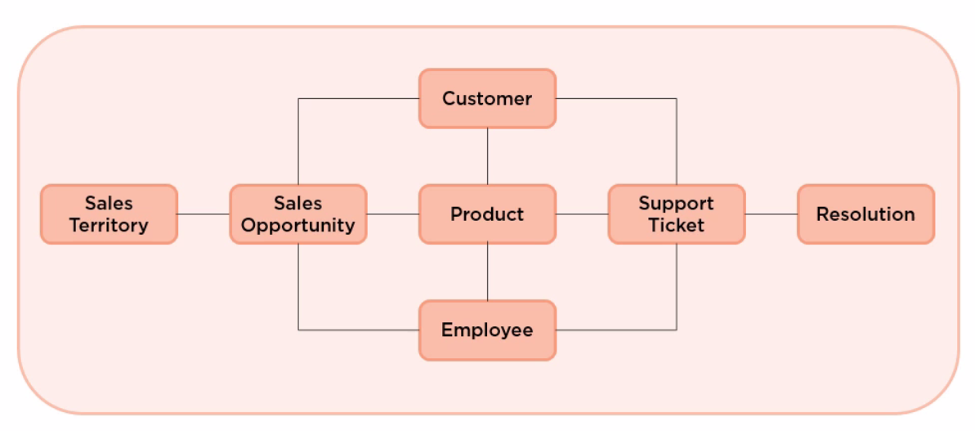
Why Microservices

Slide 26
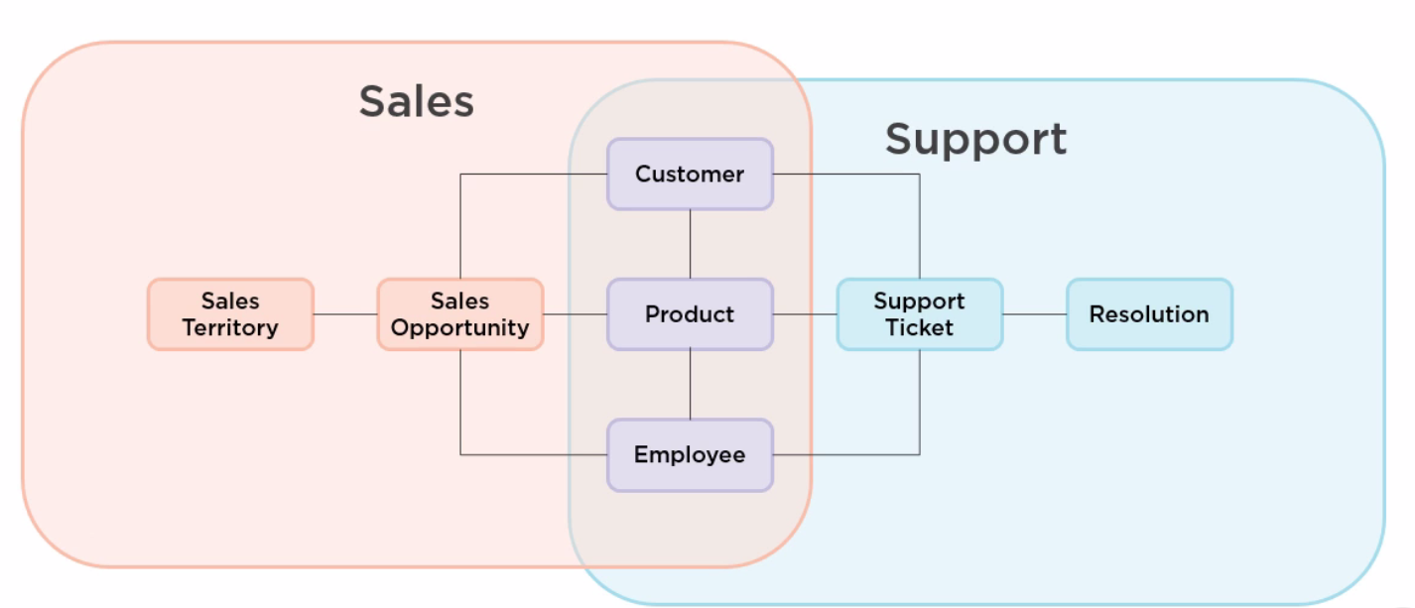
Why Microservices

Slide 27
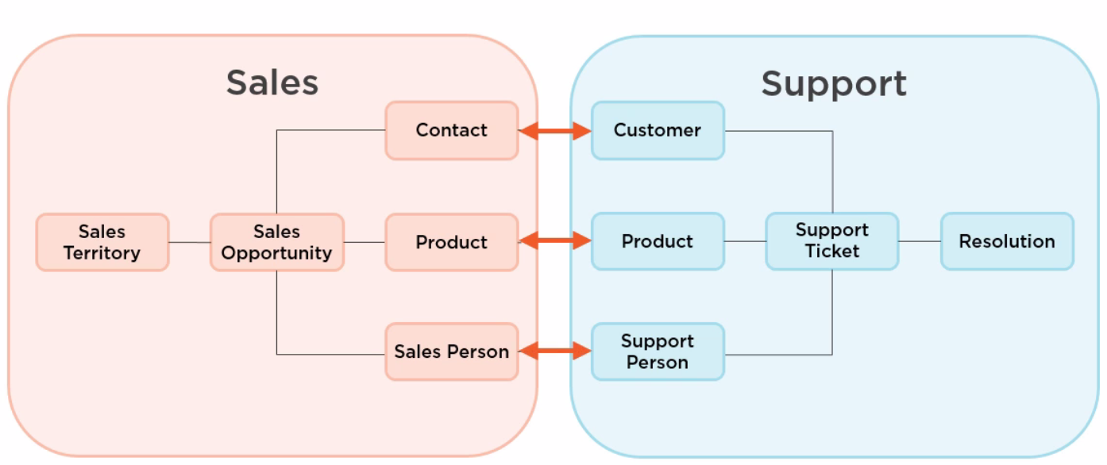
Why Microservices

Slide 28
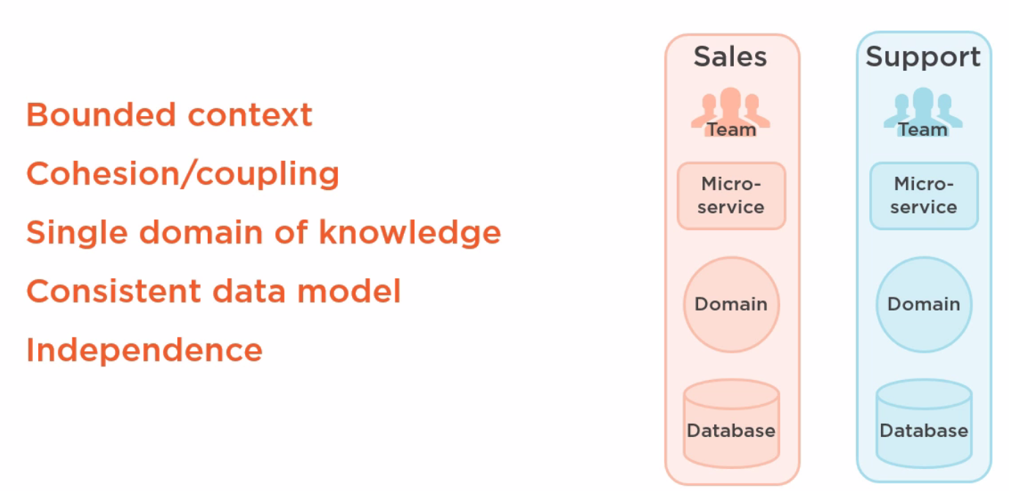
Why Microservices

Slide 29
Benefits of using microservices
Scalability
They are easier to scale individual components of an application independently
Flexibility
They allow developers to use different technologies and programming languages for different components of the application
Resilience
Failures in one service do not impact the entire application
Faster development and deployment
Microservices can be developed and deployed independently
Improved team collaboration
They encourage smaller, more focused development teams that can work more independently and collaboratively

Slide 30
Drawbacks of using microservices
Increased complexity
They add additional complexity to the development and deployment process, as multiple services must be developed, tested, and deployed independently.
Integration challenges
Because microservices are developed independently, there can be challenges in integrating them with other services and ensuring that they work together seamlessly.
Increased operational overhead
Managing multiple services can be more complex and require more resources than managing a single monolithic application.
Testing challenges
Testing microservices can be more complex than testing a monolithic application, as each service must be tested independently and in conjunction with other services.
Performance overhead
Because microservices communicate with each other over APIs, there can be additional performance overhead compared to a monolithic application that has direct access to all components.

Slide 31
Microservices Architecture

Slide 32
Key components of Microservice architecture
Microservices
Self-contained services that can be any language and function separate from one another, making them ideal for implementation through various software teams.
Containers
A package of software that functions independently and works to isolate each service in the same environment.
Service mesh
It is responsible for the communication between microservices via a messaging layer.
Service discovery
Helps manage deployment and evenly distribute the load.
API gateway
Communication in the complex distributed microservices architecture.

Slide 33
What are microservices?
A model of technical architecture
Small independent functional applications
Each microservices built on appropriate technical components
A software development pattern
Decentralization of technical components
Distributed programming / DevOps teams
Responsibility to deploy, operate, and maintain services

Slide 34
From apps to systems
Many microservices are assembled to create a complex business application
Separate independent components
Brought together via middleware or API gateway

Slide 35
Software Development Styles
Monolithic Applications
Codebase of application deployed as a single bundle of executables and libraries on a unified platform
Microservices Architecture
Multiple independent software components orchestrated to form a unified application
Common infrastructure:
User interface toolkit
API Gateway
Persistence layer

Slide 36
An internal architecture
Not necessarily apparent to users whether the application is based on microservices
Needed for fast performance, high availability, extreme transaction loads
Decentralized architecture does not imply fragmented user experience

Slide 37
Who uses Microservices
Uber
Netflix
Amazon
Ebay
Twitter
PayPal

Slide 38
Alternative approach: Monolithic software
Consolidated executable application
Plus supporting libraries and modules
Can be massively distributed across computing clusters
Entire application based on a uniform technology stack:
Server platform
Operating system
Programming language
Database layer
Enhancements mean recompilation of entire application

Slide 39
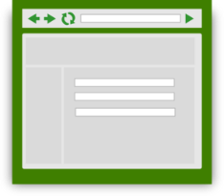
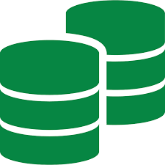
Monolithic Application Conceptual Model
Scripts/ Third Party Systems
User Interfaces
API endpoints
Web service
Presentation Layer
Application software Business Logic
Run time libraries
Database Engine
Table
Table
Table
Table
Table
Table
Table
Table
Table
Table
Table
Table
Table
Table
Table
Table

Slide 40
Services-oriented Architecture
Longstanding approach to business application development
Monolithic application based on reusable services
Complex applications rely on an enterprise service bus to manage communications among services, database connectivity, event triggers, etc
Single uniform technology platform
Code assembled into a monolithic package
Scales to very high performance through clustered deployment

Slide 41
SOA development issues
Services are closely interrelated throughout the application
Developers must understand all aspects of the application
Single technology stack
Small changes require full recompilation
Complex applications can hit hardware or OS limits
Centralized development pattern
Operations separated from Development

Slide 42
Monolithic Application: Enterprise SOA Model
Scripts/ Third Party Systems
User Interfaces
API endpoints
Web service
Presentation Layer
Application software Business Logic
}
Reusable
Composable Services
Enterprise Service Bus
Database Engine
Table
Table
Table
Table
Table
Table
Table
Table
Table
Table
Table
Table
Table
Table
Table
Table

Slide 43
Building a microservice
Small unit of functionality
Complete and independent technology stack
Separate data stores
Synchronization with other services as needed through persistence layers
Invoked through API Request / Response
Usually: REST, HTTP, JSON
Self-contained components
Inner workings not exposed externally
Developers have free reign to select tech components

Slide 44
Microservice conceptual model
Request
Response
REST / HTTPS
Microservice
Web service
Service components
Application software
Run time libraries
Data Store

Slide 45
Assembling an application
Each microservice performs a small limited task
Not intended to be standalone applications
Surrounded by specialized infrastructure
Manage communications
Orchestrate services into complex chains of tasks
Load balancing
API Gateway
User Interface layer
Externally exposed APIs
Multiple instances of any microservice launched as needed

Slide 46

Microservices-based Application
Scripts/ Third Party Systems
User Interfaces
API endpoints
Presentation Layer / UI Toolkit
API Gateway
Microservice
Web service
Microservice
Microservice
Microservice
Service components
Web service
Web service
Web service
Microservice
Service components
Service components
Service components
Web service
Microservice
Microservice
Microservice
Service components
Application software
Web service
Web service
Microservice
Microservice
Web service
Service components
Service components
Web service
Web service
Service components
Application software
Application software
Service components
Application software
Service components
Run time libraries
Application software
Application software
Run time libraries
Application software
Run time libraries
Run time libraries
Application software
Application software
Data Store
Application software
Run time libraries
Run time libraries
Data Store
Run time libraries
Data Store
Data Store
Run time libraries
Run time libraries
Run time libraries
Data Store
Data Store
Data Store
Data Store
Data Store
Data Store
Persistence / System Layer

Slide 47
Beyond Virtual Machines to Containers
Virtual machines are a common technology for optimizing use of computing hardware
Most applications use a small portion of computing and storage capacity
VM managers enable multiple instances of operating environments to co-exist on each physical server

Slide 48
Virtual Machine Environment
Multiple Virtual Machines can share a single physical server
VMs allocated via a Virtual Machine Monitor or Hypervisor
Each VM contains its own operating system, code libraries, applications, web services, and other components
Each VM independent: can host any OS, libraries, apps
VM-1
VM-2
VM-3
VM-4
Apps
Apps
Apps
Apps
Code libraries
Code libraries
Code libraries
Code libraries
Guest OS
Guest OS
Guest OS
Guest OS
Virtual Machine Monitor
Host operating system
Server Hardware

Slide 49
Containers
Server hardware provides OS Kernel to any container
Code libraries and binaries, memory, disk storage, and other resources residing on the server can be provisioned to any container
Containers can be rapidly deployed based on pre-defined configuration sets
Containers require fewer resources: do not run an entire copy of OS and support services
Containers can differ or replicate
High demand microservices may require many instances
Containers share resources but are designed to be rigidly independent
Container engine ensures against resource collisions
microservice
microservice
microservice
microservice
microservice
microservice
microservice
microservice
Binaries / Libraries set A
Bins / Libs B
Container Engine (eg: Docker)
Host operating system
Server Hardware

Slide 50
API Gateway
Requests to microservices usually not made directly from external agents
Need a layer to manage access to Microservices to enable flexible deployment
Multiple microservices may be required to perform a complex task
Usually many instances of each microservice
API Gateways provide a single entry point for all requests into the application.
Developers do not need to know physical address of each service (nothing should be hardwired)
Manage authentication, protocol conversions, communications, routing, load balancing

Slide 51
DevOps
Merges development with operations
A single team takes responsibility for development, deployment, operations, and maintenance of a microservice
Make independent technology decisions
Programming language
Databases
(probably limited to contain technical overhead for the organization)
No need to understand all aspects of the application

Slide 52
Contracts
Any given microservice will not necessarily be aware of all the ways in which it is consumed
Microservices must be persistent to avoid failures in the broader application / ecosystem
Agreement to provide specific requests/responses
Versioning is an essential characteristic
Any deprecation must be (technically) negotiated and propagated through the microservice ecosystem
Functionality cannot be withdrawn until it is no longer required

Slide 53
Docker
Leading technical environment for the management of containers
Supported in most infrastructure environments
Amazon Web Services

Slide 54
Containers
Allocate computing resources in even smaller increments than Virtual Machines
Share low-level components
Self-contained pre-configured operating environment
Container management environments provide fast and easy approach to deploy microservices or other computing components
Used in all types of computing environments, but especially well suited to microservices.

Slide 55
Container orchestration
In a complex environment tools are needed to manage the deployment of containers
Components need to be allocated and deallocated dynamically based on load and demand
Examples:
Docker Swarm
Kubernentes (developed by Google)
Apache Mesos

Slide 56
Benefits of Microservices
Rapid development
Quick path to MVP (minimal viable product)
Distributed teams
Modularity
Scalability

Slide 57
Evolving from the Monolith to Microservices
Many organizations eventually press the limits of applications built with SOA monolithic style
Gradually offload selected tasks to microservices
Full-fledged migration to microservices can be long and expensive

Slide 58
Characteristics of microservices
Self-contained
Microservices do not have external dependencies. They manage their own data and implement their own user interface.
Lightweight
Microservices communicate using lightweight protocols.
Implementation-independent
Microservices may be implemented using different programming languages and may use different technologies in their implementation.
Independently deployable
Each microservice runs in its own process and is independently deployable, using automated systems.
Business-oriented
Microservices should implement business capabilities and needs, rather than simply provide a technical service.

Slide 59
Microservice communication
Microservices communicate by exchanging messages.
A message that is sent between services includes some administrative information, a service request and the data required to deliver the requested service.
Services return a response to service request messages.
An authentication service may send a message to a login service that includes the name input by the user.
The response may be a token associated with a valid user name or might be an error saying that there is no registered user.

Slide 60
Microservice characteristics
Each microservice should have a single responsibility i.e. it should do one thing only and it should do it well.
However, ‘one thing only’ is difficult to define in a way that’s applicable to all services.
Responsibility does not always mean a single, functional activity.

Slide 61
Password management functionality
User functions
Supporting functions
Create password
Check password validity
Change password
Delete password
Check password
Backup password database
Recover password
Recover password database
Check database integrity
Repair database DB

Slide 62
Microservices architecture – key design questions
What are the microservices that make up the system?
How should data be distributed and shared?
How should microservices communicate with each other?
Microservices architecture
design
How should the microservices in the system be coordinated?
How should service failure be detected, reported and managed?

Slide 63
Synchronous and asynchronous microservice interaction
Synchronous – A waits for B
Asynchronous – A and B execute concurrently
Service A
Service A
Processing
Waiting
Processing
Processing
Processing
Calls
Requests (B)
Queue B
Queue A
Returns
Requests (A)
Processing
Processing
Processing
Processing
Service B
Service B

Slide 64
Direct and indirect service communication
Direct communication – A and B send message to each other
Service A
Service B
Indirect communication – A and B communicate through a message broker
Message broker
Service A
Service B

Slide 65
Microservice data design
You should isolate data within each system service with as little data sharing as possible.
If data sharing is unavoidable, you should design microservices so that most sharing is ‘read-only’, with a minimal number of services responsible for data updates.
If services are replicated in your system, you must include a mechanism that can keep the database copies used by replica services consistent.

Slide 66
Inconsistency management
An ACID (atomicity, consistency, isolation, durability) transaction bundles a set of data updates into a single unit so that either all updates are completed or none of them are.
ACID transactions are impractical in a microservices architecture.
The databases used by different microservices or microservice replicas need not be completely consistent all of the time.

Slide 67
Inconsistency management
Dependent data inconsistency
The actions or failures of one service can cause the data managed by another service to become inconsistent.
Replica inconsistency
There are several replicas of the same service that are executing concurrently. These all have their own database copy and each updates its own copy of the service data. You need a way of making these databases ‘eventually consistent’ so that all replicas are working on the same data.

Slide 68
Eventual consistency
Eventual consistency is a situation where the system guarantees that the databases will eventually become consistent.
You can implement eventual consistency by maintaining a transaction log.
When a database change is made, this is recorded on a ‘pending updates’ log.
Other service instances look at this log, update their own database and indicate that they have made the change

Slide 69
Service coordination
Most user sessions involve a series of interactions in which operations have to be carried out in a specific order.
This is called a workflow.
An authentication workflow for UID/password authentication shows the steps involved in authenticating a user.
In this example, the user is allowed 3 login attempts before the system indicates that the login has failed.

Slide 70
Orchestration and choreography
Service orchestration
Service Choreography
Authentication controller
Login service
Password
service
Login service
Password
service
Authentication events

Slide 71
Failure types in a microservices system
Internal service failure
These are conditions that are detected by the service and can be reported to the service client in an error message. An example of this type of failure is a service that takes a URL as an input and discovers that this is an invalid link.
External service failure
These failures have an external cause, which affects the availability of a service. Failure may cause the service to become unresponsive and actions have to be taken to restart the service.
Service performance failure
The performance of the service degrades to an unacceptable level. This may be due to a heavy load or an internal problem with the service. External service monitoring can be used to detect performance failures and unresponsive services.

Slide 72
Timeouts and circuit breakers
Timeout
A timeout is a counter that this associated with the service requests and starts running when the request is made.
Once the counter reaches some predefined value, such as 10 seconds, the calling service assumes that the service request has failed and acts accordingly.
The problem with the timeout approach is that every service call to a ‘failed service’ is delayed by the timeout value so the whole system slows down.
Circuit breaker
Instead of using timeouts explicitly when a service call is made
Like an electrical circuit breaker, this immediately denies access to a failed service without the delays associated with timeouts.

Slide 73
Using a circuit breaker to cope with service failure
Service S1
Service S2
Circuit breaker
Check S2
availability
S2 available
Set timeout
Route service request
S2 unavailable
retries <=3
Check timeout
Response S2
availability
Set S2
unavailable
retries >3
timeout fail
Increment retries
Route service response
timeout OK

Slide 74
Serverless computing and functions as a service (FaaS)

Slide 75
What is Serverless?
Serverless is a cloud computing model where cloud providers manage the cloud computing infrastructure required for providing resources according to customer needs.
In the context of serverless, servers still exist, but developers don’t have to spend their time and energy on managing these servers.
Serverless allows developers to focus on developing serverless applications and implements autoscaling based on the resource consumption by serverless applications.

Slide 76
What is Function as a Service (FaaS)?
Function as a Service is a relatively newer concept that aims to offer developers the freedom to create software functions in a cloud environment easily.
In this method, the developers will still create the application logic, yet the code is executed in stateless compute instances that are managed by the cloud provider.

Slide 77
What is Function as a Service (FaaS)?
FaaS provides an event-driven computing architecture where functions are triggered by a specific event such as message queues, HTTP requests, etc.
Some of the FaaS options available through leading cloud providers include:
Azure Functions
AWS Lambda
Google Cloud Functions
Oracle Cloud Functions
Function as a Service model adheres to a pay-as-you-go model where you have to only pay for the function when it’s used.

Slide 78
What is Function as a Service (FaaS)?
FaaS allows developers to solely focus on developing the application functionality without having to consider backend infrastructure or server configurations.
Instead, you’ll simply:
Pick the programming language of your choice.
Package the function with its software dependencies.
Finally, deploy the function.

Slide 79
FaaS Architecture
FaaS architecture is composed of three main components:
Functions
A function is a small, independent piece of code that performs a specific task.
Event sources
An event source is a trigger that causes a function to be executed.
FaaS platform
The FaaS platform is the infrastructure that runs and manages the functions

Slide 80
Best practices
Design for event-driven architectures
Minimize cold starts
Optimize performance
Use monitoring and logging
Use security best practices
Use version control
Use automated testing and deployment

Slide 81
Selection key factors
Functional requirements
Scalability
Performance
Integration
Pricing
Security
Support
Vendor lock-in

Slide 82
Security, compliance, and monitoring considerations

Slide 83
Security
Cloud-based integration solutions involve the exchange of sensitive data and information between various applications and systems over the internet.
Therefore, it is crucial to ensure that security, compliance, and monitoring are given utmost importance to protect against data breaches, cyber attacks, and regulatory violations.
Security considerations in cloud-based integration solutions involve protecting data and systems from unauthorized access and ensuring that data is encrypted both in transit and at rest.
Identity and access management (IAM) measures must be in place to ensure that only authorized personnel can access the data.

Slide 84
Compliance and monitoring
Compliance considerations involve ensuring that the integration solution meets industry-specific regulations such as HIPAA, GDPR, and PCI DSS.
Organizations must ensure that all data privacy, security, and compliance regulations are followed to avoid fines and other penalties.
Monitoring is essential to ensure that all the components of the integration solution are working correctly and to identify and address issues in real-time.
Organizations must monitor for any potential security threats, performance issues, or compliance violations.

Slide 85
Challenges
The key challenges related to security, compliance, and monitoring in the cloud environment include the complexity of the cloud infrastructure, the need to protect data across multiple cloud services and providers, and the need to meet specific compliance requirements.
Organizations must ensure that they have the necessary knowledge and expertise to implement appropriate security, compliance, and monitoring measures in the cloud environment.

Slide 86
Security
Security is a critical consideration for any cloud-based integration solution.
There are a number of security risks associated with cloud-based integration, including:
Data breaches
Denial-of-service attacks
Malware attacks
It is important to implement security measures to protect your data and applications.
Some of the security measures you can implement include:
Data encryption
Access control
Intrusion detection

Slide 87
Compliance
Compliance is another critical consideration for any cloud-based integration solution.
You need to ensure that your solution complies with all applicable regulations, such as:
HIPAA
PCI DSS
SOX
You can achieve compliance by implementing security measures and by working with a cloud provider that is compliant with the regulations that apply to your business.

Slide 88
Monitoring
Monitoring is essential for ensuring the security and compliance of your cloud-based integration solution.
You need to monitor your solution for:
Security threats
Performance issues
Compliance violations
You can monitor your solution by using a cloud monitoring tool or by implementing your own monitoring solution.

